Slide 1
Domain ML
Technology: Python
WEATHER FORECASTING USING DATA MINING

Slide 2
ABSTRACT
Weather forecasting is a method to predict what the atmosphere will be like in a particular place by using scientific knowledge to make the weather observations. Weather forecasting is a challenging task due to the dynamic and complex nature of atmospheric conditions. Recently, data mining techniques have been applied to predict weather patterns using machine learning algorithms. In this study, we propose a weather forecasting model that predicts weather types based on historical weather data. The dataset used in this study includes precipitation, temperature, wind speed, and direction collected from various weather stations. To predict weather types, we used algorithms, which is a popular machine learning technique for classification tasks. The model was trained on historical weather data and tested on a separate set of data to evaluate its accuracy. The results showed that our proposed model achieved a high accuracy rate of over 90%, indicating that it could be a valuable tool for weather forecasting. The study demonstrated that data mining techniques can be used to predict weather patterns accurately. The proposed model can provide valuable insights to weather forecasters and decision-makers in various industries such as agriculture, transportation, and aviation, which rely heavily on accurate weather predictions. The model can be improved by incorporating more weather variables, such as precipitation, cloud cover, and solar radiation, and by applying more sophisticated machine learning techniques, such as ensemble methods.
Keywords: Machine Learning, Random Forest, Logistic Regression, Decision Tree, ML techniques, evaluation.

Slide 3
INTRODUCTION
Weather Forecasting is area of current technology that predicts the atmospheric conditions for a particular location by collecting dynamic data related to weather. The knowledge of current atmospheric state is updating by various weather forecasting tools such as satellites, Balloons and aircraft, Buoys and land stations and Radar System. The data collected from states are distorted into Numerical representation is known as assimilation. Weather Predictions are essential for various applications such as climate monitoring, drought detection, agriculture and production, energy industry, aviation industry, communication, pollution dispersal etc. The technique used for weather prediction is data mining. Data mining refers to the extraction of given set of data that is useful for making predictions and correlation between different parameters. Data mining offers that to analyze datas and derive rules for weather predictions. In database the datas are stored and organized .Data mining techniques are divided into classification and clustering techniques. Classification is a data mining technique designed for classifying unknown samples. Rainfall can be easily predict using classification techniques

Slide 4
Accurate weather forecasting is critical for various sectors such as agriculture, aviation, transportation, energy, and public safety. Traditional forecasting methods rely on meteorological models, which are complex mathematical simulations of atmospheric conditions, and historical data. However, these models can be inaccurate due to the complexity of the weather system, the limited availability of data, and the uncertainty of the atmosphere's behavior.Data mining is an advanced analytical method that involves extracting patterns and knowledge from large datasets. It has become increasingly popular in weather forecasting due to its ability to handle massive amounts of data, identify hidden patterns, and provide accurate predictions. Data mining techniques can be used to analyze various weather data sources such as satellite imagery, radar data, and weather station observations.One of the most common data mining techniques used in weather forecasting is machine learning.

Slide 5

Literature survey:
S. No | Journal Type with year | Authors | Title | Outcomes
1 | Conference ICT, Cell 2011;144: volume 5 | Pushpa Mohan and Dr. Kiran KumariPatil | “Survey on Crop and Weather Forecasting based on Agriculture related Statistical Data” | farming and agriculture
2 | Conference (IEMCON), Vancouver, 2019;2:59. | Amruta A. Taksande and P. S. Mohod | “Applications of Data Mining in Weather Forecasting Using Frequent Pattern Growth Algorithm”, | Rainfall forecasting
3 | ” Conference ,pp. 1–52, 2009;4. | Fahad Sheikh and S. Karthick | “Analysis of Data Mining Techniques for Weather Prediction” | meteorological
4 | Conference vol. 53, pp. 62–74, 2018 | Prashant Biradar, Sarfraz Ansari, Yashavant Paradkar and Savita Lohiya | :“Weather Prediction Using Data Mining” | atmosphere

Slide 6
EXISTING SYSTEM
Weather forecasting is a critical application of data mining and machine learning. The existing system of weather forecasting using data mining and machine learning involves the use of historical weather data to predict future weather patterns. They have implemented Support vector machine, Naïve baye’s. To overcome all this, we use machine learning packages available in the scikit-learn library.
Disadvantages:
High complexity.
Time consuming.

Slide 7
PROPOSED SYSTEM
The proposed system of weather forecasting using data mining and machine learning involves collecting and analyzing large amounts of weather data, such as temperature, humidity, wind speed, precipitation, and atmospheric pressure. This data can be obtained from various sources, including weather stations, satellites, and other sensors. Therefore, we propose a Random Forest, Logistic Regression and Decision Tree machine Classifier to predict the weather types.
Advantages:
Highest accuracy
Reduces time complexity.
Easy to use

Slide 8
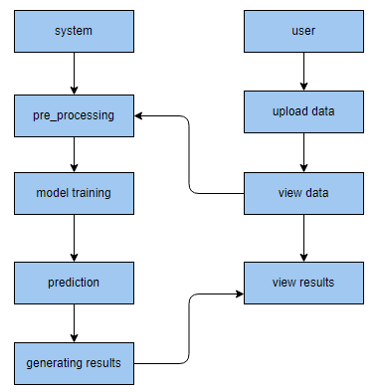
PROPOSED METHOD

Slide 9
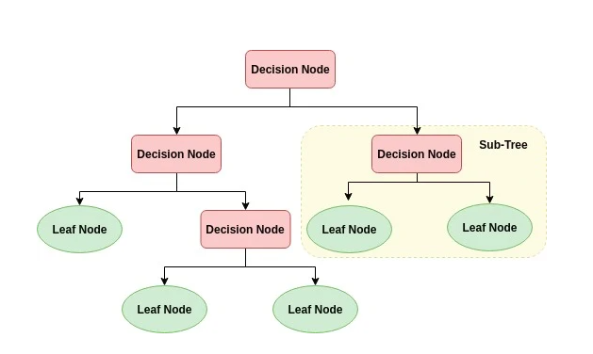
ALGORITHMS
Decision Tree:
Decision tree is a flowchart-like tree structure where an internal node represents feature(or attribute), the branch represents a decision rule, and each leaf node represents the outcome. The topmost node in a decision tree is known as the root node. It learns to partition on the basis of the attribute value. It partitions the tree in recursively manner call recursive partitioning. This flowchart-like structure helps you in decision making. It's visualization like a flowchart diagram which easily mimics the human level thinking. That is why decision trees are easy to understand and interpret.

Slide 10
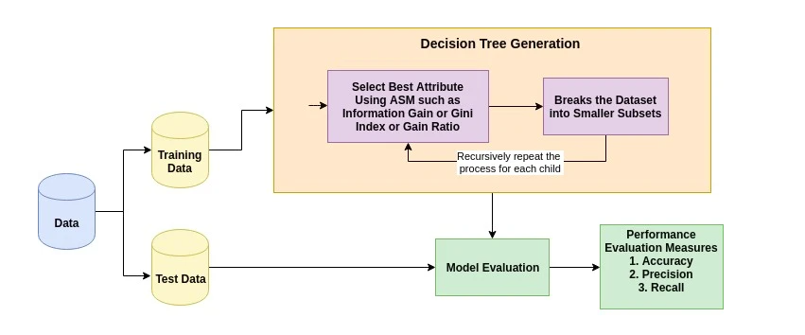
The basic idea behind any decision tree algorithm is as follows:
Select the best attribute using Attribute Selection Measures (ASM) to split the records.
Make that attribute a decision node and breaks the dataset into smaller subsets.
Starts tree building by repeating this process recursively for each child until one of the conditions will match:
All the tuples belong to the same attribute value.
There are no more remaining attributes.
There are no more instances.

Slide 11
2. Logistic Regression:
Logistic Regression was used in the biological sciences in early twentieth century. It was then used in many social science applications. Logistic Regression is used when the dependent variable(target) is categorical. For example,
To predict whether an email is spam (1) or (0)
Whether the tumor is malignant (1) or not (0)
Consider a scenario where we need to classify whether an email is spam or not. If we use linear regression for this problem, there is a need for setting up a threshold based on which classification can be done. Say if the actual class is malignant, predicted continuous value 0.4 and the threshold value is 0.5, the data point will be classified as not malignant which can lead to serious consequence in real time.
From this example, it can be inferred that linear regression is not suitable for classification problem. Linear regression is unbounded, and this brings logistic regression into picture. Their value strictly ranges from 0 to 1.

Slide 12
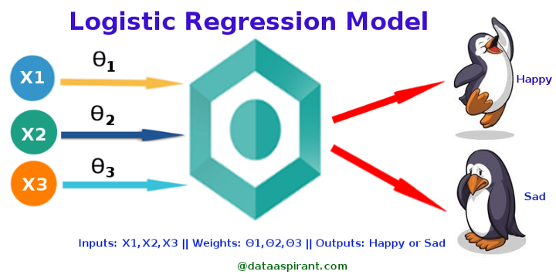
Where to use logistic regression :
Logistic regression is used to solve classification problems, and the most common use case is binary logistic regression, where the outcome is binary (yes or no). In the real world, you can see logistic regression applied across multiple areas and fields.
In health care, logistic regression can be used to predict if a tumor is likely to be benign or malignant.
In the financial industry, logistic regression can be used to predict if a transaction is fraudulent or not.
In marketing, logistic regression can be used to predict if a targeted audience will respond or not.

Slide 13
The three types of logistic regression :
Binary logistic regression - When we have two possible outcomes, like our original example of whether a person is likely to be infected with COVID-19 or not.
Multinomial logistic regression - When we have multiple outcomes, say if we build out our original example to predict whether someone may have the flu, an allergy, a cold, or COVID-19.
Ordinal logistic regression - When the outcome is ordered, like if we build out our original example to also help determine the severity of a COVID-19 infection, sorting it into mild, moderate, and severe cases

Slide 14
3. RANDOM FOREST CLASSIFIER:
A random forest is a machine learning technique that’s used to solve regression and classification problems. It utilizes ensemble learning, which is a technique that combines many classifiers to provide solutions to complex problems.
A random forest algorithm consists of many decision trees. The ‘forest’ generated by the random forest algorithm is trained through bagging or bootstrap aggregating. Bagging is an ensemble meta-algorithm that improves the accuracy of machine learning algorithms.
The (random forest) algorithm establishes the outcome based on the predictions of the decision trees. It predicts by taking the average or mean of the output from various trees. Increasing the number of trees increases the precision of the outcome.
A random forest eradicates the limitations of a decision tree algorithm. It reduces the over fitting of datasets and increases precision. It generates predictions without requiring many configurations in packages (like Scikit-learn).

Slide 15
Features of a Random Forest Algorithm:
It’s more accurate than the decision tree algorithm.
It provides an effective way of handling missing data.
It can produce a reasonable prediction without hyper-parameter tuning.
It solves the issue of over fitting in decision trees.
In every random forest tree, a subset of features is selected randomly at the node’s splitting point.
Decision trees are the building blocks of a random forest algorithm. A decision tree is a decision support technique that forms a tree-like structure. An overview of decision trees will help us understand how random forest algorithms work.
A decision tree consists of three components: decision nodes, leaf nodes, and a root node. A decision tree algorithm divides a training dataset into branches, which further segregate into other branches. This sequence continues until a leaf node is attained. The leaf node cannot be segregated further.
The nodes in the decision tree represent attributes that are used for predicting the outcome. Decision nodes provide a link to the leaves. The following diagram shows the three types of nodes in a decision tree.

Slide 16
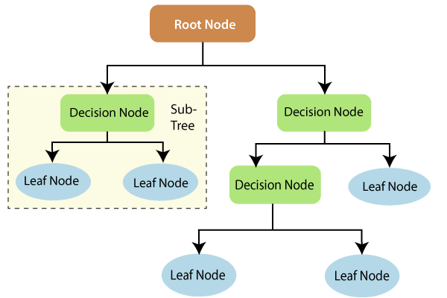
The information theory can provide more information on how decision trees work. Entropy and information gain are the building blocks of decision trees. An overview of these fundamental concepts will improve our understanding of how decision trees are built.
Entropy is a metric for calculating uncertainty. Information gain is a measure of how uncertainty in the target variable is reduced, given a set of independent variables.
The information gain concept involves using independent variables (features) to gain information about a target variable (class). The entropy of the target variable (Y) and the conditional entropy of Y (given X) are used to estimate the information gain. In this case, the conditional entropy is subtracted from the entropy of Y.

Slide 17
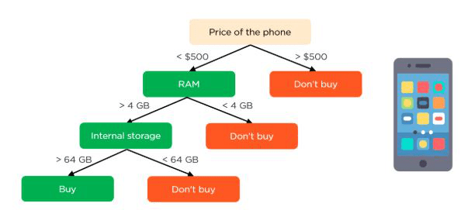
Information gain is used in the training of decision trees. It helps in reducing uncertainty in these trees. A high information gain means that a high degree of uncertainty (information entropy) has been removed. Entropy and information gain are important in splitting branches, which is an important activity in the construction of decision trees.
Let’s take a simple example of how a decision tree works. Suppose we want to predict if a customer will purchase a mobile phone or not. The features of the phone form the basis of his decision. This analysis can be presented in a decision tree diagram.
The root node and decision nodes of the decision represent the features of the phone mentioned above. The leaf node represents the final output, either buying or not buying. The main features

Slide 18
HARDWARE AND SOFTWARE REQUIREMENTS
H/W Configuration:
Operating system : Windows 7 or 7+
RAM : 8 GB
Hard disc or SSD : More than 500 GB
Processor : Intel 3rd generation or high or Ryzen with 8 GB Ram
S/W Configuration:
Software’s : Python 3.6 or high version
IDE : PyCharm.
Framework : Django, pandas, numpy and Scikit-Learn

Slide 19
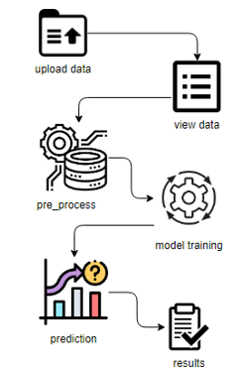
ARCHITECTURE:

Slide 20
UML DIAGRAMS
UML stands for Unified Modelling Language. UML is a standardized general-purpose modelling language in the field of object-oriented software engineering. The standard is managed, and was created by, the Object Management Group.
The goal is for UML to become a common language for creating models of object-oriented computer software. In its current form UML is comprised of two major components: a Meta-model and a notation. In the future, some form of method or process may also be added to; or associated with, UML.
The Unified Modelling Language is a standard language for specifying, Visualization, Constructing and documenting the artefacts of software system, as well as for business modelling and other non-software systems. The UML represents a collection of best engineering practices that have proven successful in the modelling of large and complex systems.
The UML is a very important part of developing objects-oriented software and the software development process. The UML uses mostly graphical notations to express the design of software projects.

Slide 21
GOALS:
The Primary goals in the design of the UML are as follows:
Provide users a ready-to-use, expressive visual modelling Language so that they can develop and exchange meaningful models.
Provide extendibility and specialization mechanisms to extend the core concepts.
Be independent of particular programming languages and development process.
Provide a formal basis for understanding the modelling language.
Encourage the growth of OO tools market.
Support higher level development concepts such as collaborations, frameworks, patterns and components.
Integrate best practices.

Slide 22
USE CASE DIAGRAM
A use case diagram in the Unified Modeling Language (UML) is a type of behavioral diagram defined by and created from a Use-case analysis.
Its purpose is to present a graphical overview of the functionality provided by a system in terms of actors, their goals (represented as use cases), and any dependencies between those use cases.
The main purpose of a use case diagram is to show what system functions are performed for which actor. Roles of the actors in the system can be depicted.

Slide 23
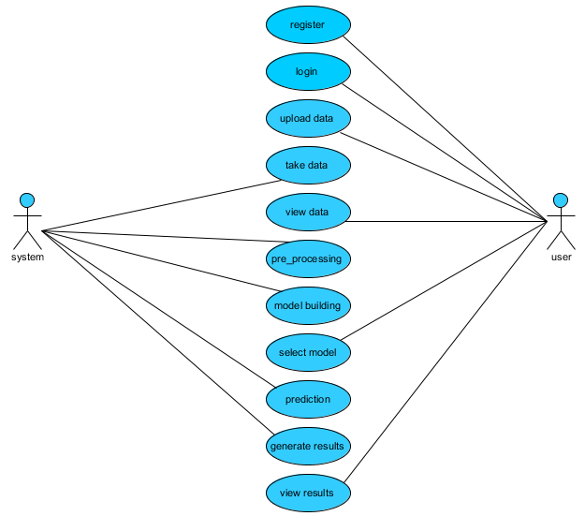

Slide 24
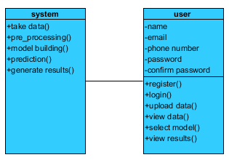
CLASS DIAGRAM
In software engineering, a class diagram in the Unified Modeling Language (UML) is a type of static structure diagram that describes the structure of a system by showing the system's classes, their attributes, operations (or methods), and the relationships among the classes. It explains which class contains information

Slide 25
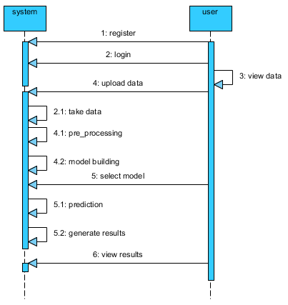
SEQUENCE DIAGRAM
A sequence diagram in Unified Modeling Language (UML) is a kind of interaction diagram that shows how processes operate with one another and in what order.
It is a construct of a Message Sequence Chart. Sequence diagrams are sometimes called event diagrams, event scenarios, and timing diagrams

Slide 26
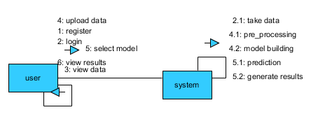
COLLABORATION DIAGRAM:
In collaboration diagram the method call sequence is indicated by some numbering technique as shown below. The number indicates how the methods are called one after another. We have taken the same order management system to describe the collaboration diagram. The method calls are similar to that of a sequence diagram. But the difference is that the sequence diagram does not describe the object organization whereas the collaboration diagram shows the object organization.

Slide 27
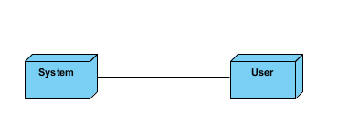
DEPLOYMENT DIAGRAM
Deployment diagram represents the deployment view of a system. It is related to the component diagram. Because the components are deployed using the deployment diagrams. A deployment diagram consists of nodes. Nodes are nothing but physical hardware’s used to deploy the application.

Slide 28
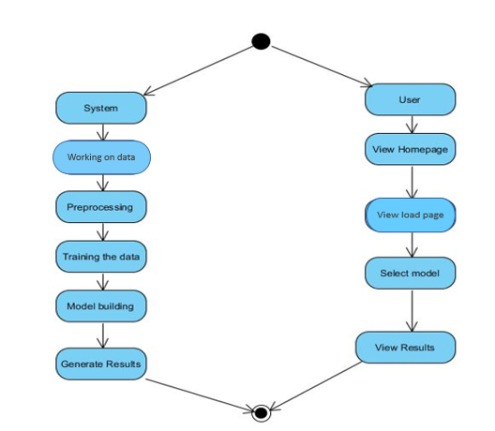
ACTIVITY DIAGRAM:
Activity diagrams are graphical representations of workflows of stepwise activities and actions with support for choice, iteration and concurrency. In the Unified Modelling Language, activity diagrams can be used to describe the business and operational step-by-step workflows of components in a system. An activity diagram shows the overall flow of control.

Slide 29
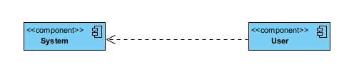
COMPONENT DIAGRAM:
A component diagram, also known as a UML component diagram, describes the organization and wiring of the physical components in a system. Component diagrams are often drawn to help model implementation details and double-check that every aspect of the system's required function is covered by planned development.

Slide 30
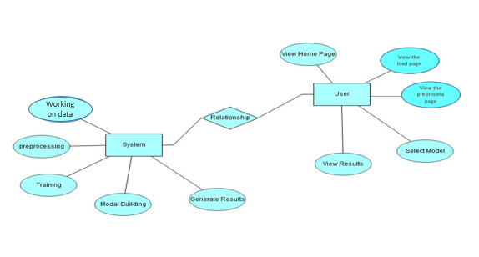
ER DIAGRAM:
An Entity–relationship model (ER model) describes the structure of a database with the help of a diagram, which is known as Entity Relationship Diagram (ER Diagram). An ER model is a design or blueprint of a database that can later be implemented as a database. The main components of E-R model are: entity set and relationship set.
An ER diagram shows the relationship among entity sets. An entity set is a group of similar entities and these entities can have attributes. In terms of DBMS, an entity is a table or attribute of a table in database, so by showing relationship among tables and their attributes, ER diagram shows the complete logical structure of a database. Let’s have a look at a simple ER diagram to understand this concept.

Slide 31
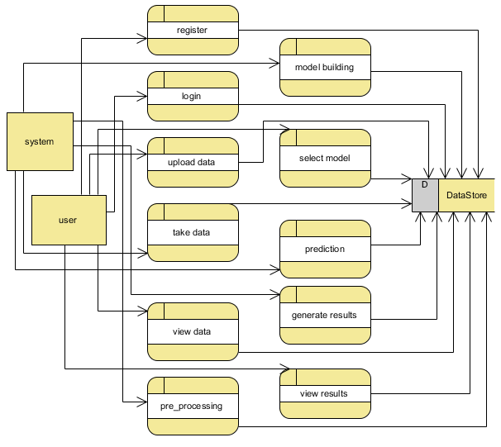
DFD DIAGRAM:
A Data Flow Diagram (DFD) is a traditional way to visualize the information flows within a system. A neat and clear DFD can depict a good amount of the system requirements graphically. It can be manual, automated, or a combination of both. It shows how information enters and leaves the system, what changes the information and where information is stored. The purpose of a DFD is to show the scope and boundaries of a system as a whole. It may be used as a communications tool between a systems analyst and any person who plays a part in the system that acts as the starting point for redesigning a system.

Slide 32
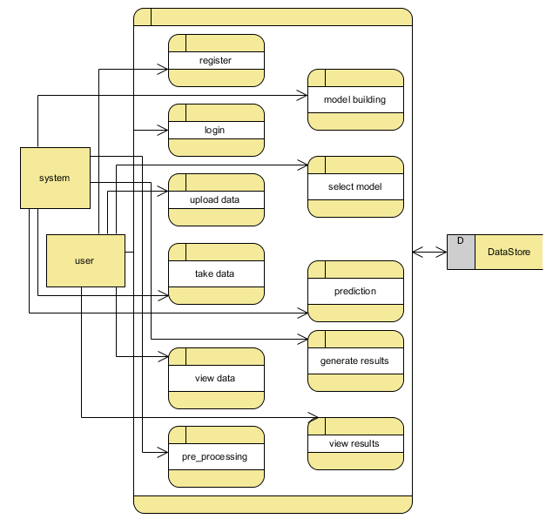

Slide 33
CONCLUSION:
In conclusion, machine learning has revolutionized the field of weather forecasting. By using machine learning algorithms to analyse vast amounts of historical weather data, meteorologists can now make more accurate and timely predictions of future weather conditions. Machine learning models can learn complex relationships between different weather variables and use that knowledge to make accurate predictions in real-time. This is critical for various sectors such as agriculture, transportation, and public safety, where accurate weather forecasting can help save lives, reduce costs, and increase efficiency. Machine learning is also helping to advance the field of weather forecasting by providing new insights into the behavior of the atmosphere and helping to identify new weather patterns. Overall, data mining using machine learning is a powerful tool for weather forecasting and will continue to play an essential role in providing accurate and timely weather information to society.

Slide 34
REFERENCES:
[1] Pushpa Mohan and Dr. Kiran KumariPatil: “Survey on Crop and Weather Forecasting based on Agriculture related Statistical Data”, International Journal of Innovative Research in Computer and Communication Engineering, Volume 5, Issue 2
[2] Amruta A. Taksande and P. S. Mohod: “Applications of Data Mining in Weather Forecasting Using Frequent Pattern Growth Algorithm”, International Journal of Science and Research
[3] Fahad Sheikh and S. Karthick: “Analysis of Data Mining Techniques for Weather Prediction”,Indian Journal of Science and Technology, Volume 9
[4] PrashantBiradar, Sarfraz Ansari, YashavantParadkar and Savita Lohiya:“Weather Prediction Using Data Mining”,International Journal of engineering research and development,Volume 5, Issue 2
[5] AishwaryaDhore, AnaghaByakude, Bhagyashri Sonar and Mansi Waste: “ Weather prediction using the data mining Technique”

Slide 35


